Slide 1
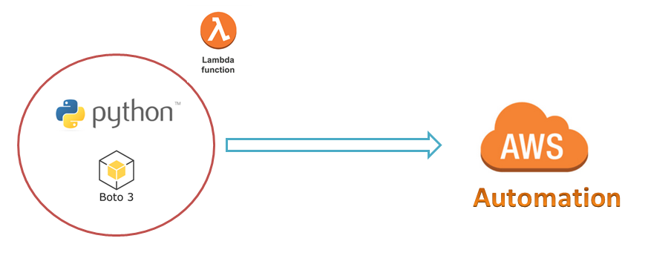
AWS Automation
with
boto3 of Python and Lambda Functions
Boto3 meta Concept
Loop control statements or commands
(break and continue)
Learn how to automate AWS common tasks using boto3 and Lambda

Slide 2

Boto3 Concepts:
The core concepts of boto3 are:
Session
Resource
Client
Meta
Collections
Waiters
Paginators
Loop control statements or commands
(break and continue)
Learn how to automate AWS common tasks using boto3 and Lambda

Slide 3
Boto3 meta object:
Useful to enter into client object from resource.
List Available Regions for EC2 Service
Loop control statements or commands
(break and continue)
Learn how to automate AWS common tasks using boto3 and Lambda

Slide 4
Thank you

